Slide 1
Contributing to Django
How I learned to stop worrying and just try to fix an ORM Bug

Slide 2
First DjangoCon?
Notes:
How many people are attending their first DjangoCon

Slide 3
Introduction
Notes:
My name is Ryan Cheley and today I’m going to talk about my experience fixing a bug in the Django ORM
But first, a side quest
When I was 15 (in 1993) my Boy Scout troop did a trip to Mt Whitney.

Slide 4
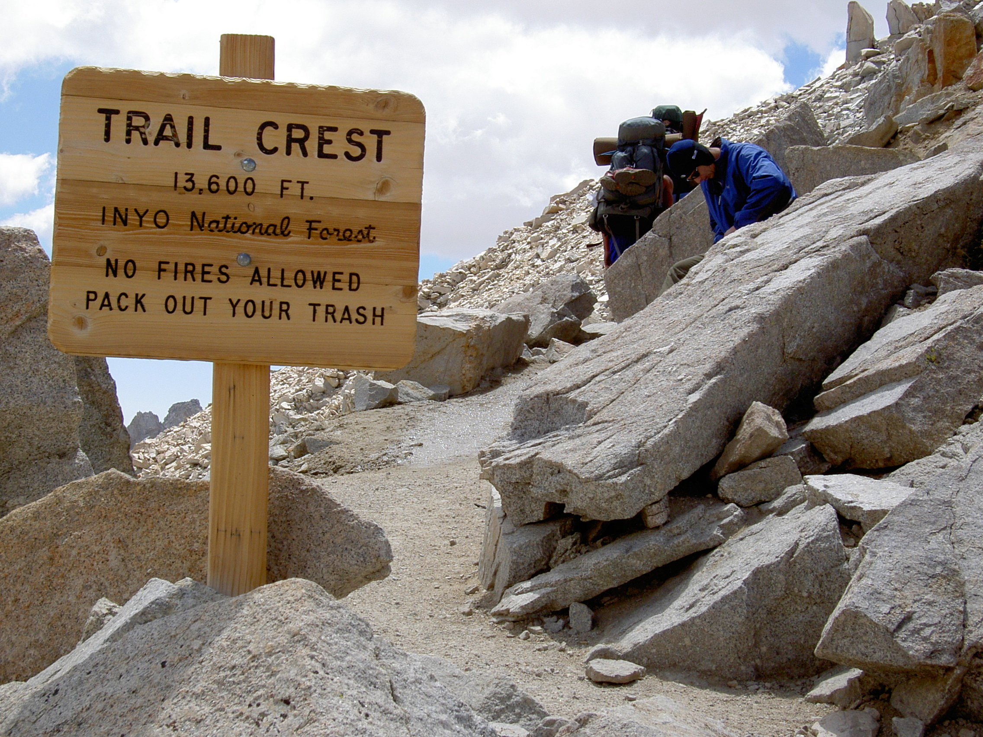
Notes:
There I was ... at the top of the Mt Whitney Portal, 13,600 ft (4159 m) above sea level
I had spent the 7 days hiking to get here.
I was only 3 miles from the summit of Mt Whitney ... but I wasn't sure I could go any further.
My hiking companions told me I didn't look so good. Truth be told, I didn't feel so good either.
Did I make it to the summit?

Slide 5
Trying to get to DjangoCon US
2018 💼
2019 💼
2020 🦠
2021 🧑🏻‍💻
2022 🧍🏻
Notes:
I’ve been trying to make it to DjangoCon US since 2018
2018: But, I had a work conference I had to attend.
2019: It happened again in 2019
2020: I was *determined* to go in 2020 ... but we all know what happened there
2021: I was able to attend the online version in 2021
2022: And then I finally made it in person 2022 … And it was amazing.

Slide 6
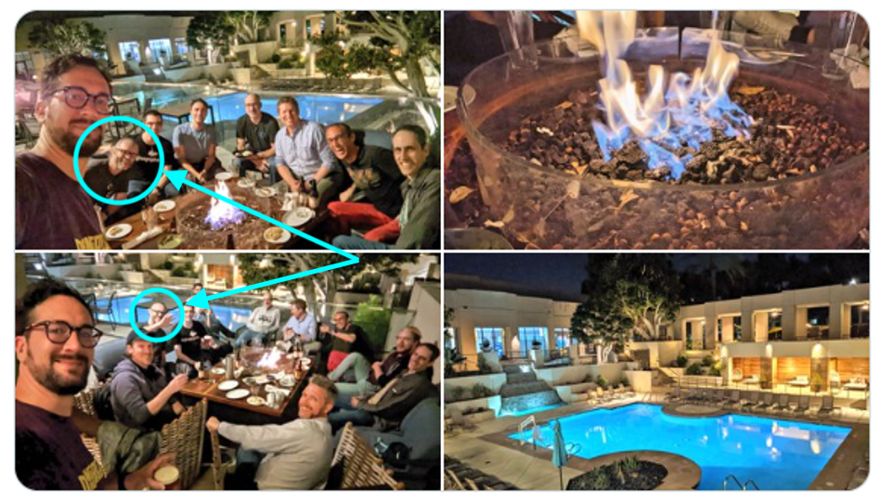
Notes:
You can see me in the pictures on the left … I had *slightly* longer hair then ☺

Slide 7
🏃🏻‍♂️
Notes:
Sprints
I was very excited about attending the sprints and working on *something* ORM related
My strategy for finding a ticket was to find something old, that seemed straightforward(ish) and then just go for it.
I spent some time during the conference trying to find something, and by the day of the sprints I had been able to narrow it down to a single ticket

Slide 8
Criteria
Old?
It was opened in January of 2009
Straightforard(ish)
It’s related to SQLite
Ticket 10070
Named parameters not working on raw sql queries with sqlite

Slide 9
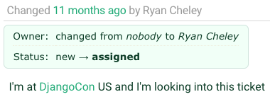
Notes:
I assigned the ticket to myself

Slide 10
🔍
Notes:
Reviewing the Ticket
I spent time reviewing the ticket and then speaking with Simon Charette about it. It *seemed* as though it wasn't a problem anymore

Slide 11
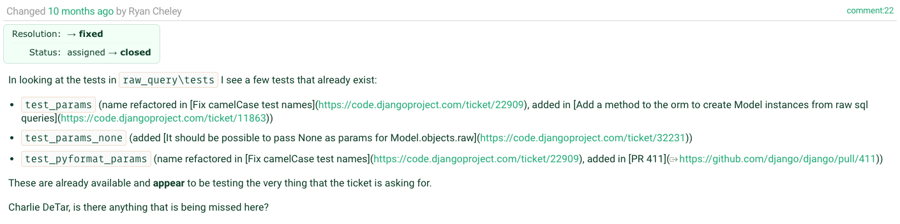
Notes:
And so I added a comment to the ticket

Slide 12
🎉
Notes:
Marking the Ticket as Done!

Slide 13
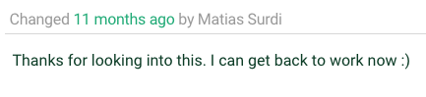
Notes:
A comment on the issue thanking me for working on the ticket … the original reporter for the ticket!

Slide 14
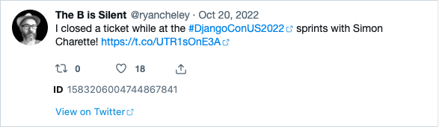
Letting everyone know!
Notes:
I was so excited that I let the world know about it on the bird site

Slide 15
🏠
Notes:
I spent the rest of my time at the sprints working on other non-ORM related tickets in other Django related projects
And I headed home having been able to fix a bug in the ORM!!!!
….

Slide 16

Notes:
And I felt *really* good about this

Slide 17
But then …

Slide 18
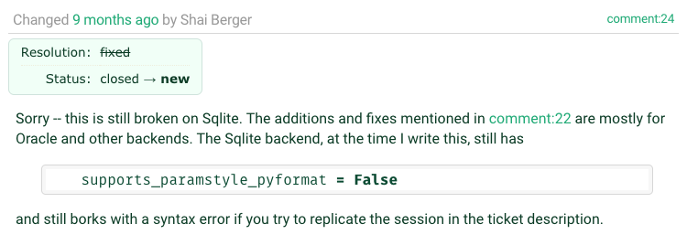
Notes:
Shai Berger is a member of the Django Security team

Slide 19
😩
Notes:
Oh No!
I was faced with two potential choices:

Slide 20
🙈🙉🙊
Notes:
Ignore the bug. It had been a bug for YEARS … it was opened on January 19, 2009 (13 YEARS!!!!) and didn’t seem to have caused any MAJOR issues

Slide 21
🛠️
Notes:
Fix
Try to work it on my “own”

Slide 22
Feelings …
Notes:
I also had lots of feelings surrounding the discovery of the bug still existing

Slide 23
😳
Notes:
Embarrassed
I declared it fixed on the Bird Site
I had people at the DjangoCon Sprints ASK ME HOW I DID IT!

Slide 24
😞
Notes:
Disappointed
I felt like I let people down
I felt like I let *myself* down

Slide 25
😨
Notes:
Fear
Imposter Syndrome – Can I work on this on “my own”

Slide 26
Community
Notes:
But then I remembered a talk that Carlton Gibson gave at DjangoCon US 2018 “Your Framework Needs You”. It's a great talk and you should totally watch it, but here are the highlights that I got out of it

Slide 27
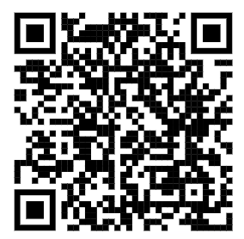
Your Web Framework Needs You!
Ticket difficulty
The Review Process can be challenging
You can do it!
Notes:
1. The vast majority of tickets are no harder than the work you do to solve every single day using Django
a. Yes they need, time, thought, and a little bit of your love
b. If you get stuck while trying to solve it you can ask for help!
2. The review process is hard
a. … and everyone gets the same review process;
b. it’s not personal
3. You can do it.
a. You are qualified!
b. If you’ve spent time working on an issue you are
4.

Slide 28
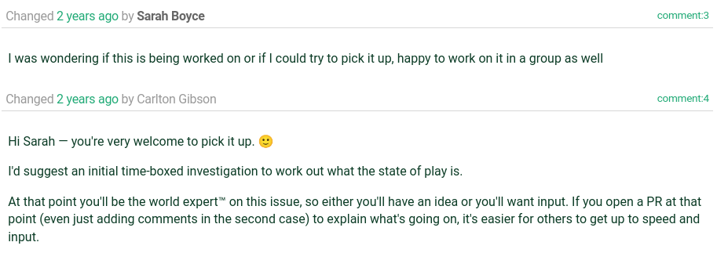
The World’s Foremost Expert

Slide 29
Working on the Ticket
Notes:
I went to work on the ticket and did what most of us do when we’re assigned a Bug for work, or on a personal project

Slide 30
Replicate the Bug ♊
Read some docs 📖
Write some code ✍🏻
Test the Code 🧪
Write down what you learned 📜

Slide 31
♊
Notes:
Replicate the Bug

Slide 32
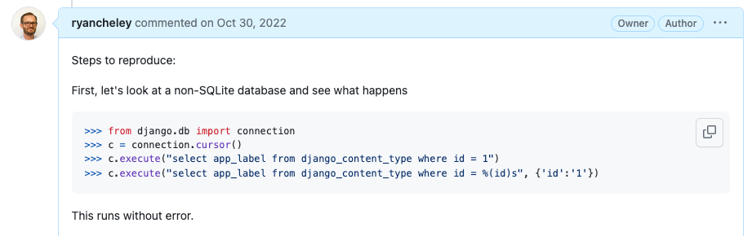

Slide 33
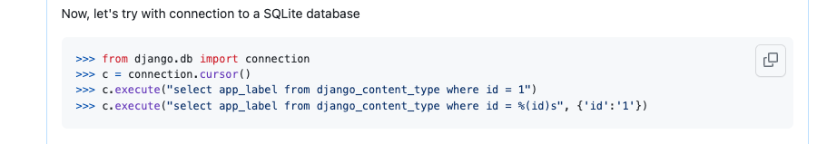

Slide 34
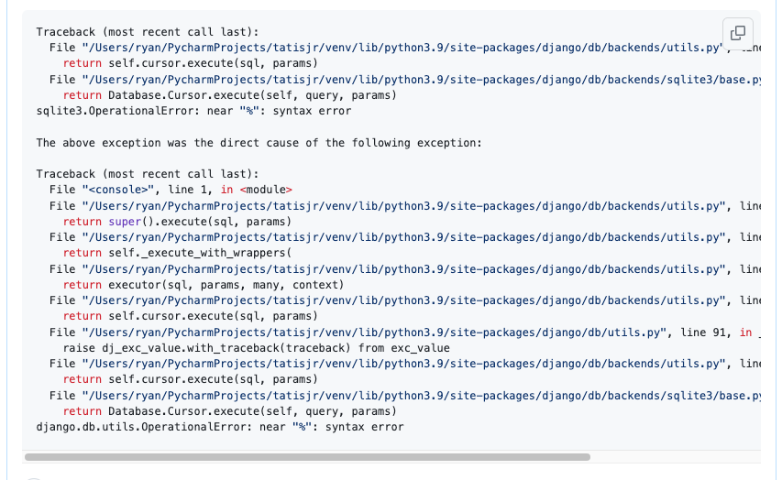

Slide 35
📖
Notes:
Read some docs

Slide 36
✍🏻
Notes:
Write some code

Slide 37
Details to be added
Notes:
Screenshots of conversation up to here

Slide 38
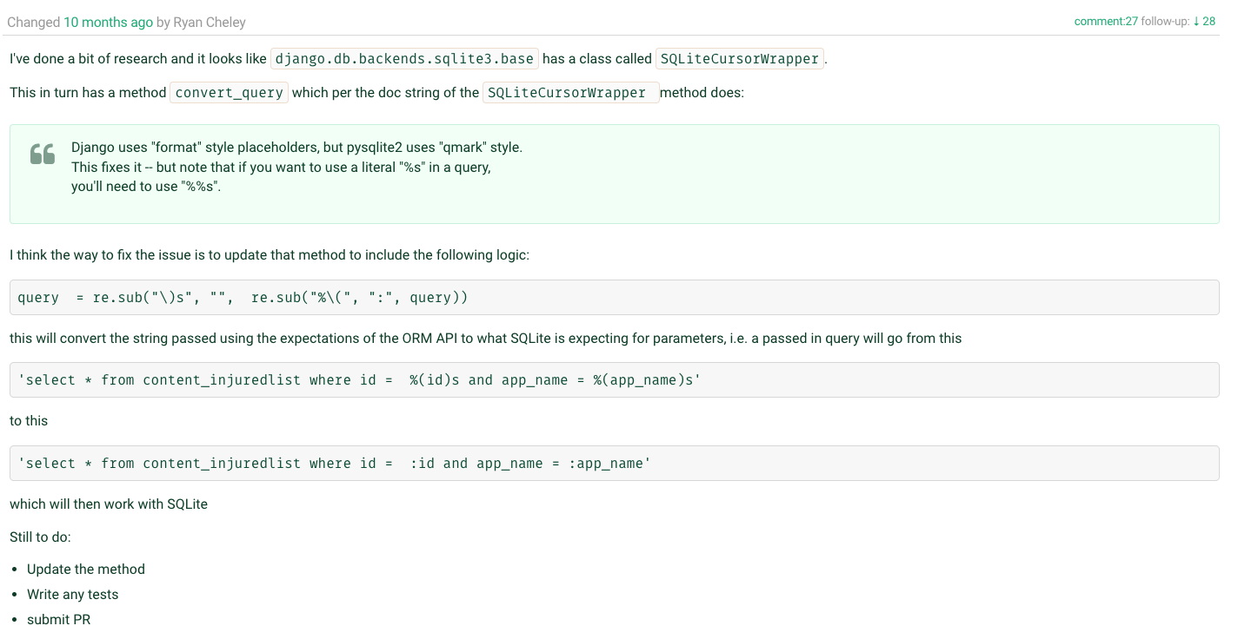

Slide 39
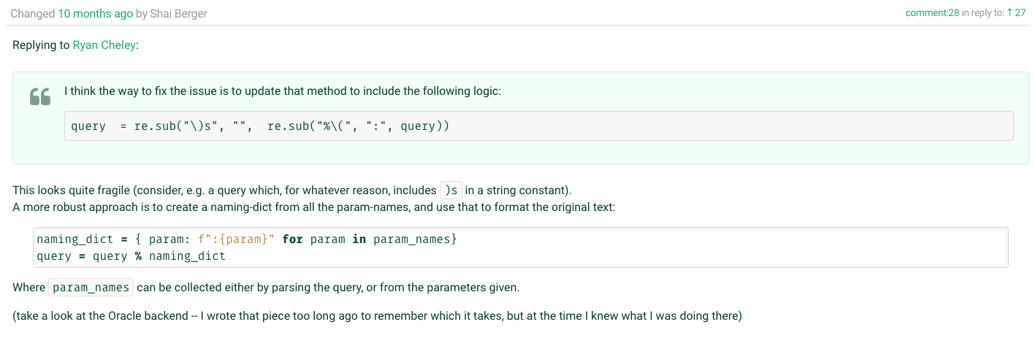

Slide 40
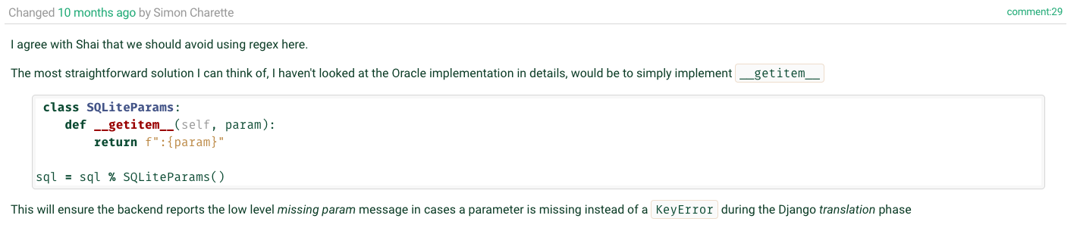

Slide 41
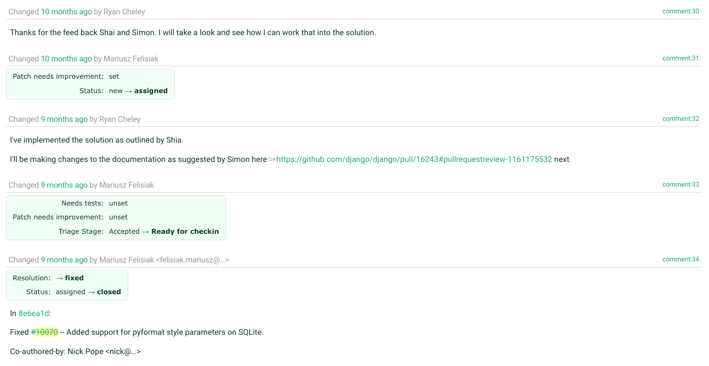

Slide 42
🧪
Notes:
Test the code that you wrote

Slide 43
Testing Hypothesis Matrix
 | Flag = False | Flag = True
Original Code | N-1 Tests Should pass 1 test should be skipped | N-1 Tests Should pass 1 test should fail
Updated Code | N-1 Tests Should pass 1 test should be skipped | All tests should pass
*Flag = supports_paramstyle_pyformat

Slide 44
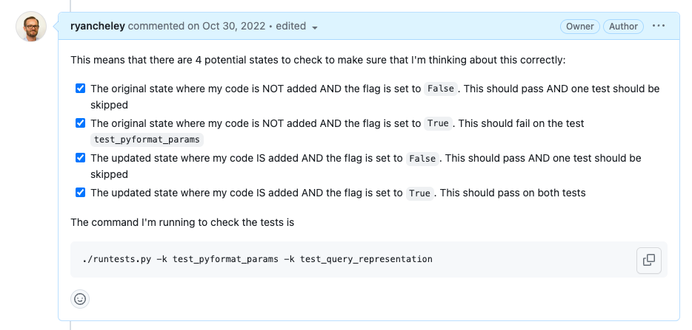
Notes:
Four States to check
The original state where my code is NOT added AND the flag is set to False. This should pass AND one test should be skipped
The original state where my code is NOT added AND the flag is set to True. This should fail on the test test_pyformat_params
The updated state where my code IS added AND the flag is set to False. This should pass AND one test should be skipped
The updated state where my code IS added AND the flag is set to True. This should pass on both tests

Slide 45
📜
Notes:
Write down what you’re learning as you’re learning … because we all do this, right?
I didn’t, until I saw this talk by Simon Willison at DjangoCon US 2022 titled, “Massively increase your productivity on personal projects with comprehensive documentation and automated tests”

Slide 46
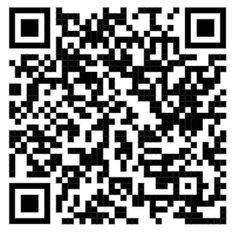
Public Notes
Notes:
At DjangoCon US 2022 Simon Willison gave a great talk which included an idea called ‘public notes’. I highly recommend watching that talk and implementing the public notes idea
This was the first time I used the idea, but I've used it a few more times since then as I try to learn about a thing. I’ve even started doing it at my joby-job
Essentially you use an issue (in this case a GitHub issue) as a spot to work through a problem and leave yourself breadcrumbs for what you’ve tried and learned, basically doing what you would do in the ‘scientific method’

Slide 47
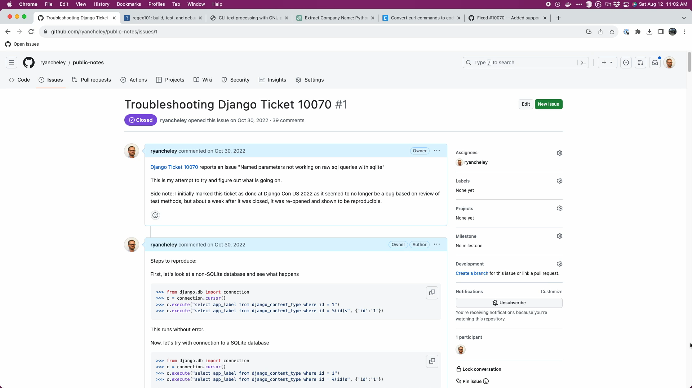
Notes:
40 comments as a conversation to myself, back and forth from Oct 30, 2022 to Nov 8, 2022 (10 days!)

Slide 48
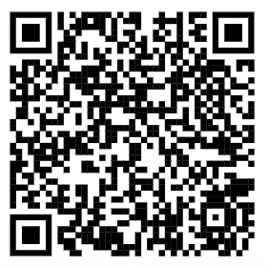
My Public Notes
Notes:
In my notes there’s a lot of back and forth, two steps backward, 1 step forward kind of things, but even looking at it now, I can see my thought process for how the bug ended up getting fixed

Slide 49
The fix
Notes:
Ultimately the fix was made, but it wasn’t just *me*. I had a lot of help in getting the code to the right spot.
Nick Pope
Shia Berger
Simon Charette
Mariusz Felisiak

Slide 50

Nick Pope

Slide 51
Remove Code Duplication
%(value)s to :value
generators
Notes:
There is duplication which should be pushed down into .convert_query().
Converting %(value)s to :value in this way will also convert %%s to %s which will then be incorrectly converted to ? in .convert_query(). We should not perform both conversions¹ and a test should be added to ensure this doesn't happen.
Converting param_list to a list in .executemany() will saddle us with poor performance. We many have been passed a generator and the current approach will force all of the parameters to be materialized. The approach needed requires that we can peek at the first item in the generator without consuming the lot.

Slide 52
Shia Berger

Slide 53
Identified fragility
Notes:
Feedback that the approach had some fragility https://code.djangoproject.com/ticket/10070#comment:28
with Simon Charette agreeing https://code.djangoproject.com/ticket/10070#comment:29
And that regex should be avoided

Slide 54

Simon Charette

Slide 55
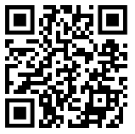
Gave great Keynote at DjangoCon US 2022 on the State of the ORM
Awesome primer on ORM at Sprints
Update to the docs!
Notes:
He gave a great keynote at DjangoCon US 2022
And an awesome primer on the ORM in general at the sprints
Remember to update the docs!

Slide 56

Mariusz Felisiak

Slide 57
Simplified comments
Merged the PR

Slide 58
Lessons

Slide 59
The ORM can seem BIG and Scary
Notes:
The ORM can seem big and scary
The code for Django can seem big and scary

Slide 60
The Code for Django can seem BIG and Scary
Notes:
The ORM can seem big and scary
The code for Django can seem big and scary

Slide 61
But remember
Notes:
The ORM can seem big and scary
The code for Django can seem big and scary

Slide 62
The Django ORM …

Slide 63
Is Python

Slide 64
In fact, all of Django …

Slide 65
Is Python

Slide 66
Looking at Tickets
Notes:
So when you go to look for a ticket to take, remember that there is an amazing community here that wants to see you succeed …

Slide 67
Look At
Read
Write
Notes:
and at the end of the day the code you’re going to look at, read, and write

Slide 68
Is Python

Slide 69
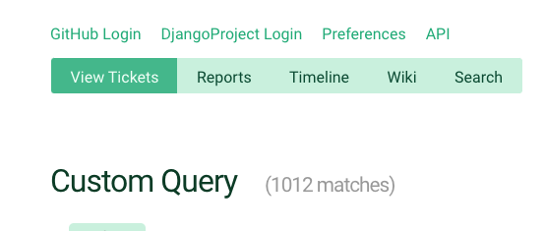
Notes:
So when you’re ready to dive in to one of the currently <> open tickets, just keep that in mind

Slide 70
Notes:
This is where I will put other OSS accomplishments
- updated docs on DjangoPackages
-

Slide 71
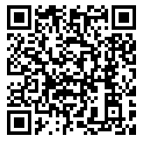
Trac
Notes:
And because this is Django, there is great documentation on how to triage tickets and work through them

Slide 72
Notes:
Back to Mt Whitney
I was **only** three miles from the summit, but I just wasn’t feeling **it**.
My fellow hikers didn’t discourage me from continuing, but they didn’t really encourage me either.
I didn’t make it to the summit that day and it’s been a regret ever since. I’ve not attempted another big hike
But why am I telling this story? What does this have to do with fixing a bug in the Django ORM.
When the bug wasn’t resolved I had an option to ignore it / give up. I could have NOT gone to the summit of the BUG
But the community helped me to work through it. The solution that was ultimately submitted and merged wasn’t just mine, it was through the hard work of a couple of different people.
This community wants you to succeed. They want you to learn.
If this community had been up there with me that day, I’m 100% sure that I would have made it to the summit because of the encouragement that is provided and the determination to want **you** to succeed

Slide 73
So remember …

Slide 74
Your Framework needs YOU

Slide 75
Community
Notes:
And there’s a great community to support you and wants to see you succeed and learn

Slide 76
Thank you

Slide 77
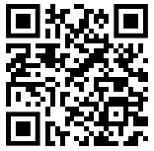
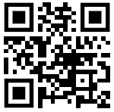
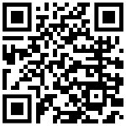
Find me on …
Platform | QR Code
Mastodon https://mastodon.social/@ryancheley
GitHub https://github.com/ryancheley/
LinkedIn https://www.linkedin.com/in/ryan-cheley/

